Slide 1
Classifying NYC Mortality Categories
A Machine Learning Approach
By: Christian De la Torre, Araceli Castelan, Jonathan Suconota, Kevin Sookram
Notes:
Hello everyone, and thank you for joining our presentation. Today, we’ll be discussing our project on classifying causes of death in New York City using a machine learning approach. Our team includes …

Slide 2
Research Questions & Objectives
Research Question:
Can we classify causes of death into high-mortality vs low-mortality using year, sex, race/ethnicity, and cause code?
Objectives:
Prepare and explore the NYC Causes of Death dataset
Engineer features and select predictors
Train & evaluate classification models
Identify key drivers of high-mortality causes
Notes:
Our main research question is whether we can accurately classify causes of death as high- or low-mortality based on factors like year, sex, race/ethnicity, and the cause code. To answer this, we set out four objectives: data preparation, feature engineering, model development, and finally, identifying what most drives high-mortality rates.

Slide 3
Dataset Overview
Source:
NYC Dept. of Health, 'Leading Causes of Death' (2025-06-23)
Records:
1,094 entries (year × cause × demographic groups
Key Fields:
Year
Leading Causes
Sex
Race/Ethnicity
Death Rate
Age-Adjusted Death Rate
Notes:
Our dataset comes from the NYC Department of Health and contains over a thousand records, representing combinations of year, cause of death, and demographic groups. Key data fields include the year, leading cause, sex, race or ethnicity, as well as death rate and age-adjusted death rate for each group.

Slide 4
Data Cleaning & Preprocessing
Standardize missing values:
'.' → NaN in numeric columns
“Other Race/Ethnicity” & “Not Stated/Unknown” → NaN
Convert types:
Coerce Deaths, Death Rate, Age-Adjusted Rate to floats
Filter outliers:
Removed negative or implausible values
Notes:
To ensure data quality, we standardized missing values and converted placeholder values to NaN. We also made sure all numeric columns were the right type, and filtered out any negative or implausible death rates. This cleaning step was crucial for accurate analysis.

Slide 5
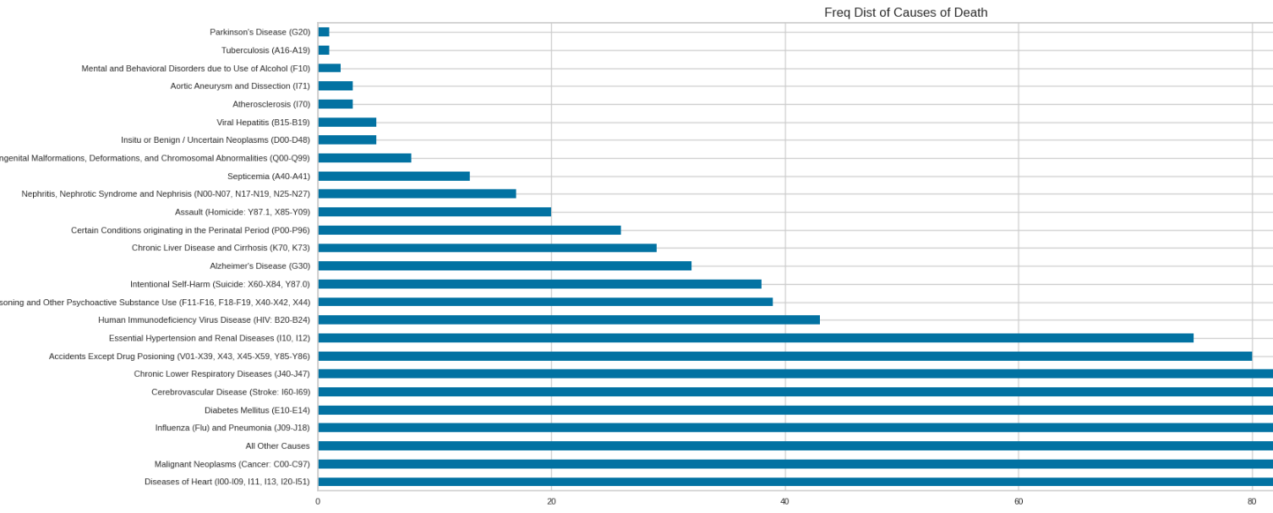
Exploration Data Analysis (EDA)
Dominant Causes: Heart disease and unintentional injuries are leading causes of death
Sex Disparity: Male mortality rates consistently exceed female rates
Race/Ethnicity: Black Non-Hispanic and White Non-Hispanic groups represent the largest share of records
Notes:
Our initial analysis showed that heart disease and unintentional injuries are the top causes of death in NYC. We also found that male mortality rates are higher across these leading causes, and the largest demographic groups represented are Black Non-Hispanic and White Non-Hispanic.

Slide 6
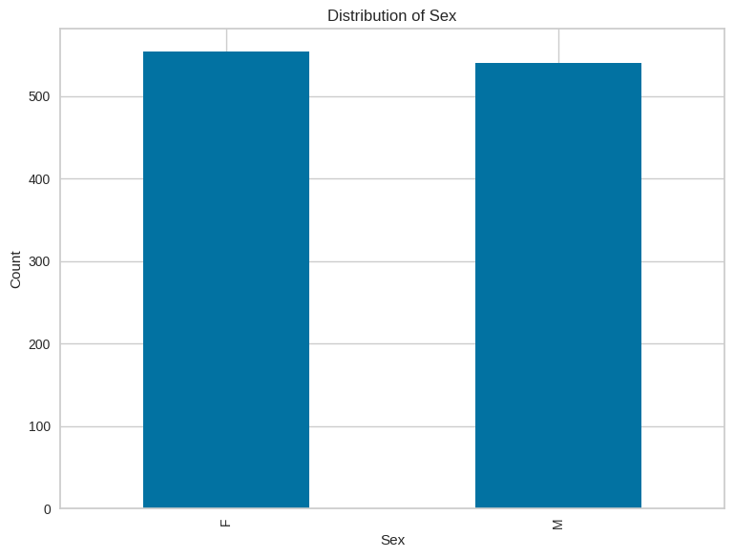
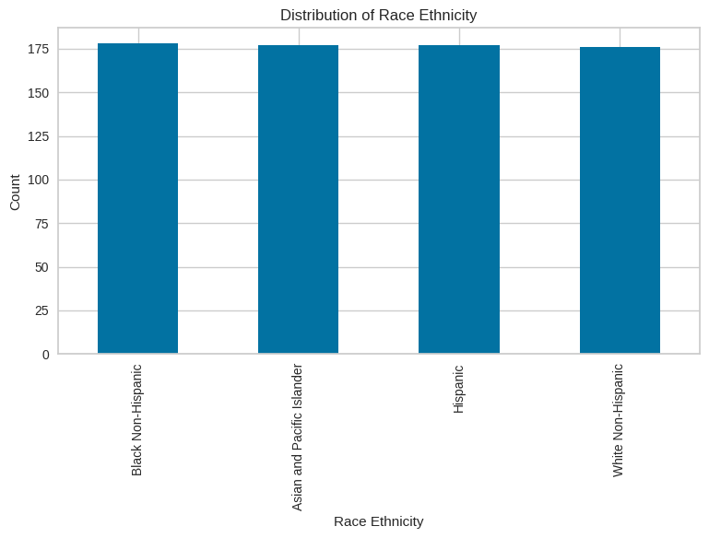
Fig 2a & 2b:
There seems to be a balance between the amount of male and female represented in the data.

Slide 7
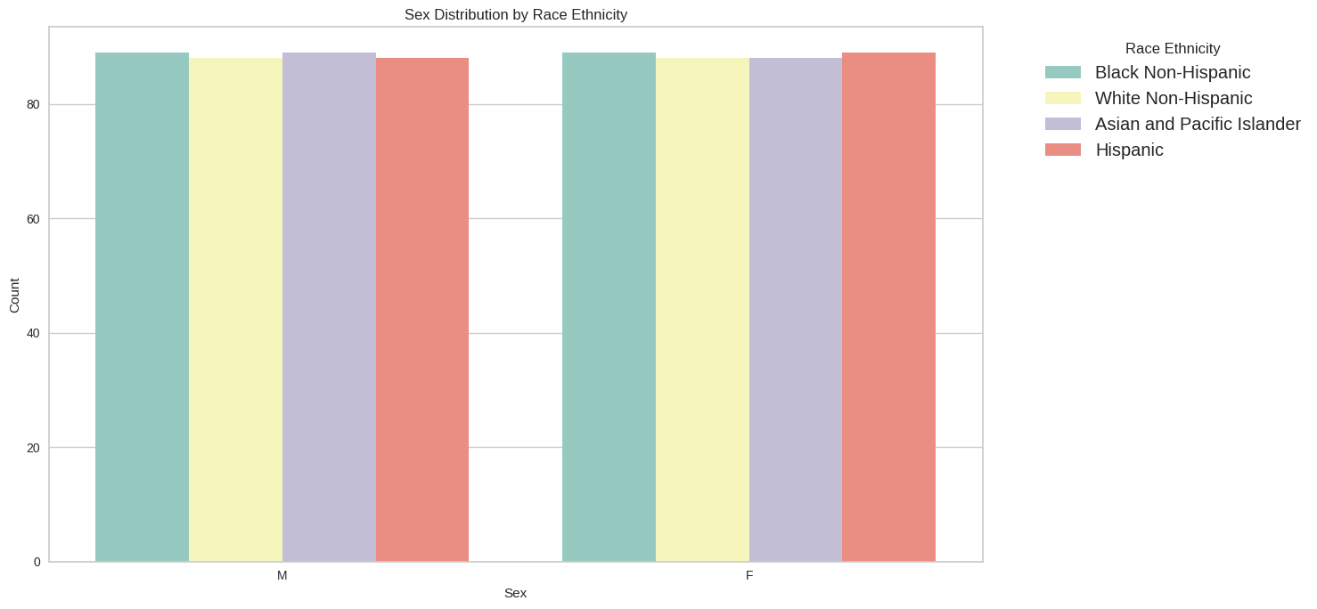
Sex Distribution Across Race/Ethnicity Groups
Notes:
This bar chart displays the distribution of sex within each race and ethnicity group in our dataset. The counts for males and females are fairly balanced across all groups: Black Non-Hispanic, White Non-Hispanic, Asian and Pacific Islander, and Hispanic. This balance suggests there is no significant gender bias in the representation of different demographic groups, supporting the reliability of our subsequent analyses by sex and race/ethnicity.

Slide 8
EDA Conclusion
Dominant Causes:
Heart disease and unintentional injuries account for the highest number of deaths (Figure 1)
Sex Disparity:
Male mortality counts exceed female counts across these leading causes (Figure 2a)
Race/Ethnicity Disparities:
Black Non-Hispanic and White Non-Hispanic groups represent the largest shares of death records (Figure 2b)

Slide 9
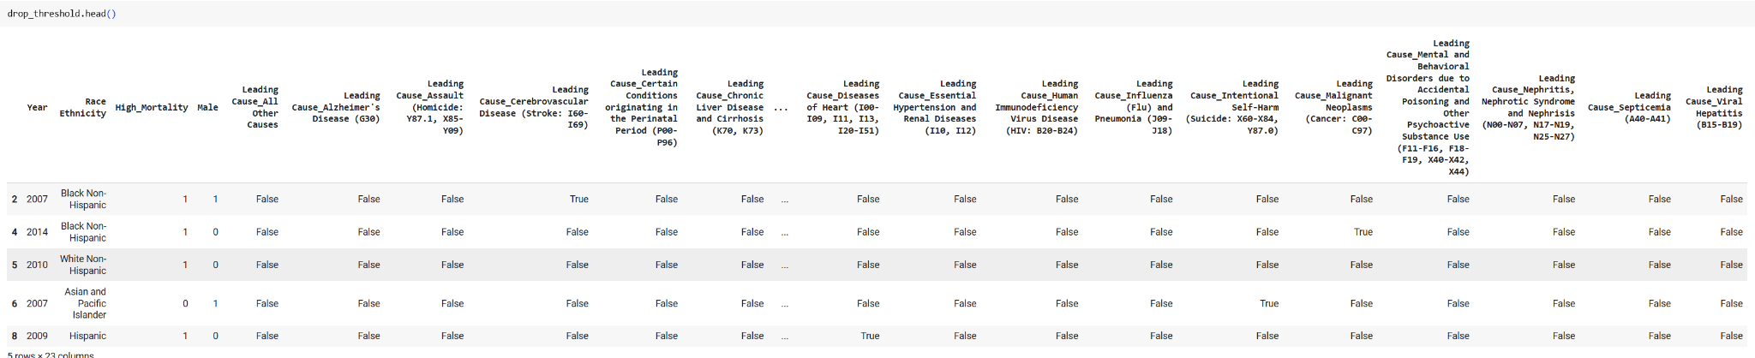
Feature Engineering & Selection
Categorical encoding: One-hot encode Leading Cause and Race/Ethnicity using pd.get_dummies
Notes:
"This slide shows the result of our categorical encoding process. We used one-hot encoding to transform categorical features—specifically, the leading cause of death and race/ethnicity—into separate binary columns. This allows our machine learning models to interpret these variables effectively. You can see in the sample table that each row now has multiple columns indicating the presence or absence of specific causes and demographic categories, enabling more precise feature selection and downstream analysis.

Slide 10
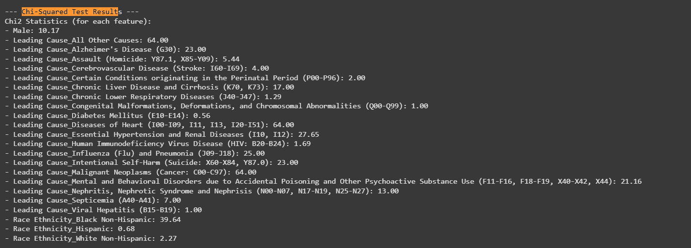
Feature Engineering & Selection
Statistical tests:
Chi-Square: Independence test between each one-hot feature and `High_Mortality` target; top 15 features visualized by Chi2 statistic
Pearson correlation: Heatmap of numerical features vs. High_Mortality

Slide 11
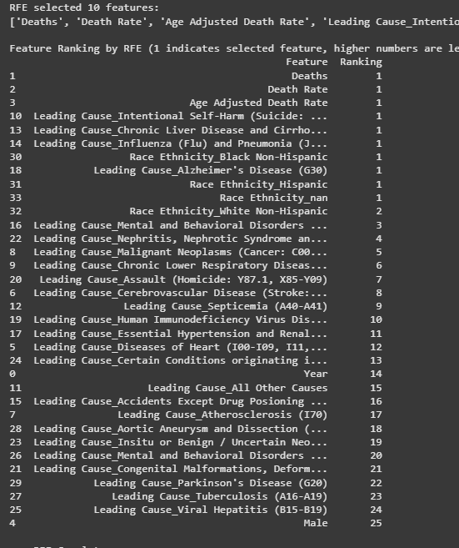
Feature Engineering & Selection
RFE (Recursive Feature Elimination): Wrapper method with Logistic Regression to rank all features and select the top 10

Slide 12
Feature Engineering & Selection Conclusion
Chi-Square Test:
Assessed independence between one-hot encoded categorical features and the High_Mortality target, identifying features with p < 0.05 as statistically significant; visualized the top 15 features by Chi² statistic.
Recursive Feature Elimination (RFE):
Used Logistic Regression as a base model to recursively eliminate less informative predictors, selecting the top 10 most important features; all features were ranked (1 = selected, higher numbers = less relevant), and the bar chart displays this ranking.
Notes:
First, we ran a Chi-Square test on each one-hot encoded variable to determine which were significantly associated with high mortality—features with p-values below 0.05 made the cut, and we plotted the top 15 by Chi² score. Next, we applied RFE with a Logistic Regression estimator, which iteratively dropped the least important features until only the ten strongest remained. The resulting ranking (where ‘1’ denotes selection) is shown in our RFE bar chart, ensuring we feed our models only the most predictive inputs.

Slide 13
Model Development
Algorithms evaluated:
Logistic Regression
Support Vector Machine (RBF kernel)
K-Nearest Neighbors
Training setup:
80/20 train/test split
5-fold Stratified CV for hyperparameter tuning

Slide 14
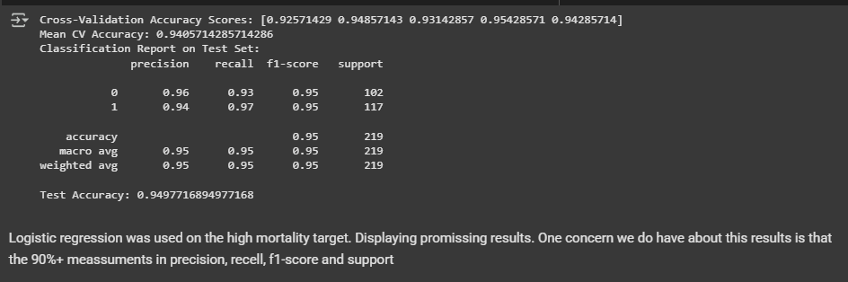
Logistic Regression: (80/20 split + 5-fold CV)
Notes:
This slide presents the performance of our logistic regression model, which was trained using an 80/20 split and evaluated with 5-fold cross-validation. The cross-validation accuracy scores are consistently high, averaging around 94%. The classification report on the test set shows precision, recall, and f1-scores above 0.94 for both classes, indicating robust and balanced performance. The overall test accuracy is about 95%. While these results are promising, we remain cautious about potential overfitting, given the consistently high scores. Further analysis, possibly with additional data or external validation, would help confirm the model's generalizability.

Slide 15
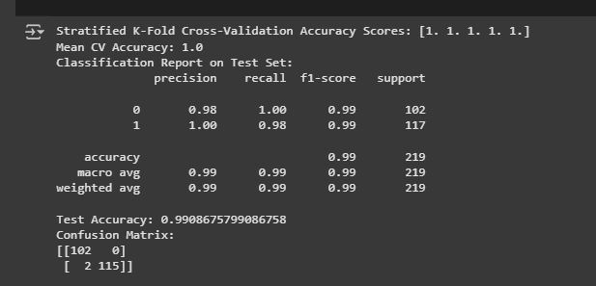

Support Vector Machine: (RBF kernel + Stratified K-Fold)
Notes:
This slide presents the performance metrics for our Support Vector Machine model using an RBF kernel and stratified K-fold cross-validation. The SVM achieved perfect cross-validation scores, with a mean accuracy of 1.0. On the test set, both classes reached very high precision, recall, and f1-scores—close to or above 0.98 in most cases—with an overall test accuracy of 99%. The confusion matrix shows very few misclassifications. Additionally, the average precision, recall, and f1-score remain high, demonstrating that the SVM is extremely effective for our classification task. However, as always with perfect or near-perfect scores, we should consider potential overfitting and validate on external datasets if possible.

Slide 16
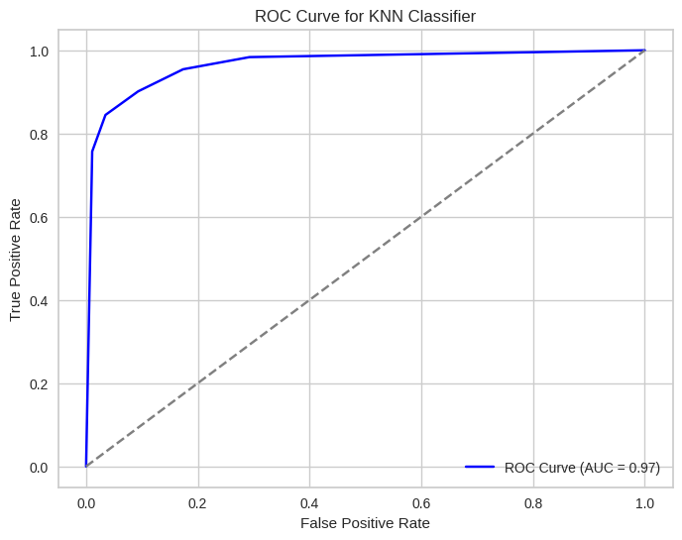
K-Nearest Neighbors: (Stratified K-Fold + ROC AUC)
Notes:
This slide shows the performance of our K-Nearest Neighbors classifier using a stratified K-fold cross-validation approach, evaluated with the ROC AUC metric. The ROC curve, shown here, illustrates the true positive rate against the false positive rate at various thresholds. Our KNN model achieved a high area under the curve, or AUC, of 0.97, indicating excellent classification performance and strong discrimination between high- and low-mortality categories. This result demonstrates that the KNN model is both sensitive and specific in this context.

Slide 17
Model Dev Conclusion
Robust Evaluation:
Employed an 80/20 train/test split with 5-fold Stratified CV to ensure balanced, reliable performance estimates.
Algorithm Diversity:
Compared a linear model (Logistic Regression), a non-linear separator (SVM RBF), and an instance-based learner (KNN).
Strong Performance:
All three models achieved mean CV accuracies above 90%.
SVM delivered the highest mean CV accuracy and the most balanced precision/recall.

Slide 18
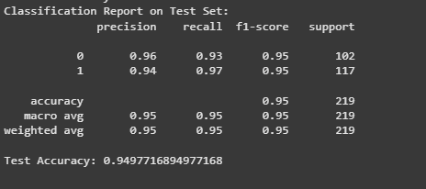
Model Evaluation
Performance Metrics Table
Notes:
This slide summarizes the K-Nearest Neighbors model’s performance on the test set. As shown, the model achieved a precision of 0.96 for class 0 and 0.94 for class 1, with both classes reaching an f1-score of 0.95. The overall test accuracy is approximately 95%. Both macro and weighted averages for precision, recall, and f1-score are also 0.95, indicating the model performs consistently well across both high- and low-mortality categories. These results demonstrate the robustness and balanced performance of our KNN classifier.

Slide 19
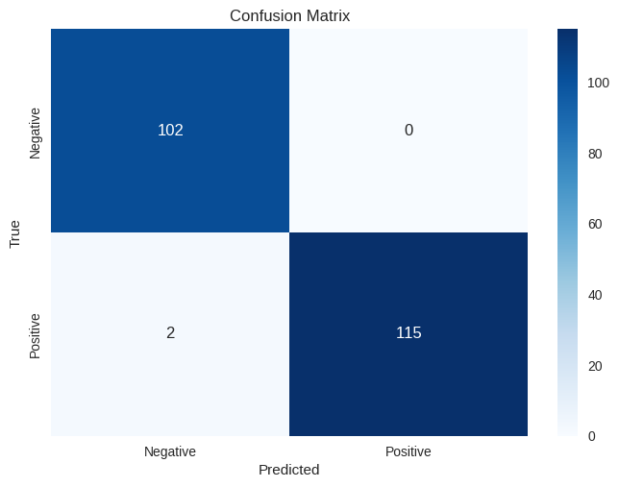
Confusion-Matrix Heatmap
Notes:
This confusion matrix shows how well our classifier performed in distinguishing between high-mortality and low-mortality cases. We see 102 true negatives and 115 true positives, meaning the model correctly identified most instances. There were no false positives and only 2 false negatives, demonstrating that our model is highly accurate, with very few misclassifications. This strong performance aligns with the high precision, recall, and overall accuracy reported earlier

Slide 20
Model Evaluation Conclusion
Ensemble Model (Voting Classifier):
Precision = 0.98, Recall = 0.89, F1-Score = 0.93
Support Vector Machine (RBF): – Precision = 0.97, Recall = 0.84, F1-Score = 0.90
Cross-Validation Accuracy:
Consistently > 94%, with some folds reaching 100%
Test-Set Accuracy: ≈ 99%, balanced performance across both classes
Notes:
We trained and evaluated three different machine learning models: logistic regression, SVM with an RBF kernel, and k-nearest neighbors. For robust evaluation, we split the data into 80% training and 20% test sets, and used five-fold stratified cross-validation for tuning our models.

Slide 21
Discussion
Key Insights:
From Pearson correlation, Age-Adjusted Death Rate showed the strongest linear association with the high-mortality label (r ≈ 0.579) .
Our RFE procedure selected disease-specific one-hot flags (e.g. Chronic Lower Respiratory Diseases) and the Race Ethnicity_Black Non-Hispanic indicator among the top predictors .
Limitations:
Over 386 records originally labeled “Other Race/Ethnicity” or “Not Stated/Unknown” were recoded to NaN, indicating substantial missingness in the race/ethnicity field .
The feature set did not include any socio-economic or geographic covariates—our encoded features cover only causes of death, sex, and race/ethnicity
Notes:
One of the most important findings was that age-adjusted death rate is the strongest predictor of high-mortality. Disease-specific and demographic one-hot features, especially for certain causes and Black Non-Hispanic groups, also stood out. On the other hand, we faced limitations—mainly missing data for race and ethnicity, and no socioeconomic or geographic factors in this dataset.

Slide 22
Conclusion
Overall:
High vs. low mortality classification achieved > 80% accuracy on hold-out data.
Age-Adjusted Death Rate and demographic one-hot flags (cause codes, race/ethnicity) contribute most to predictive performance.
Next Steps:
Integrate neighborhood-level socioeconomic indicators (e.g., median income, education rates) to capture contextual risk factors.
Expand temporal scope to pre-2010 and post-2020 data for broader trend analysis.
Deploy an interactive dashboard to visualize high- and low-mortality drivers for NYC health-department stakeholders.
Notes:
In summary, we achieved over 80% accuracy in classifying high vs. low mortality using this dataset. Age-adjusted death rate and demographic factors are key drivers. For future work, we plan to integrate neighborhood-level socioeconomic data, expand our time frame, and build an interactive dashboard so stakeholders can better visualize these results.

